Slide 1

Regex Matching Web App Development Project

Slide 2


ABOUT ME
Name : Singireddy Pravalika
Qualification : MSC
Any work experience : Fresher
I want to learn data science for skills and to get a job in scientist field.
It has great job opportunities.

Slide 3

Objective of the Project:
Your task is to replicate the core functionality of the website regex101.com.
This entails creating a web application that allows users to input a test string and a regular expression (regex) and displays all the matches found.

Slide 4
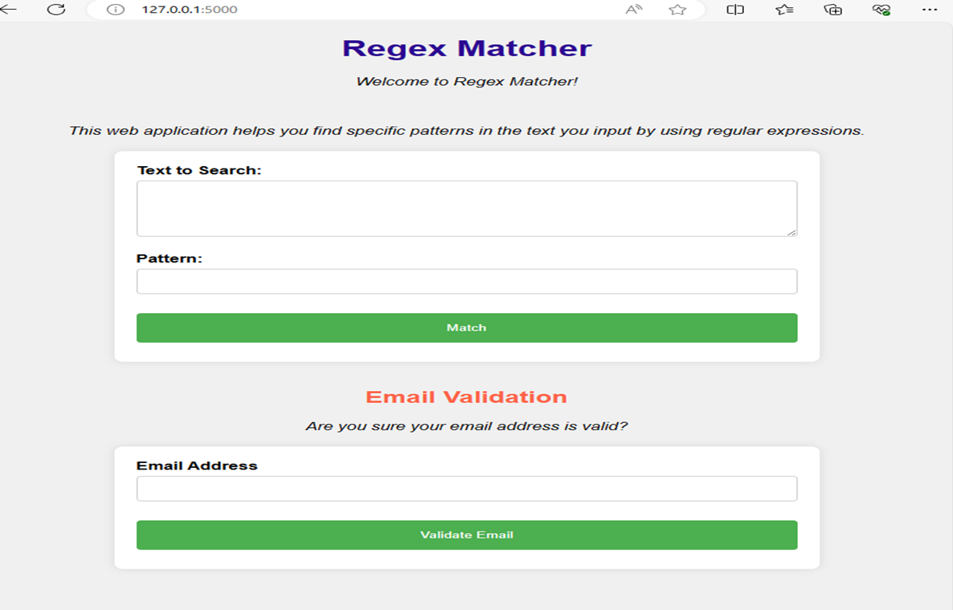


Slide 5
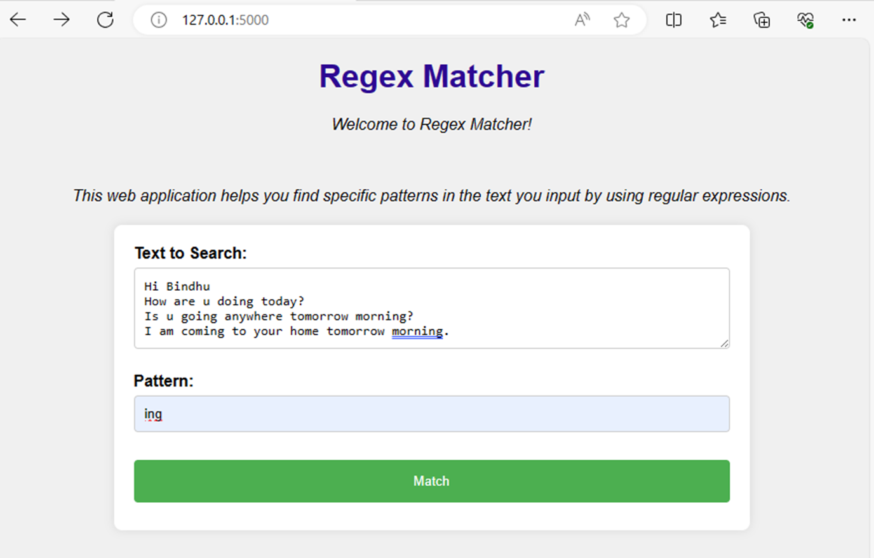


Slide 6
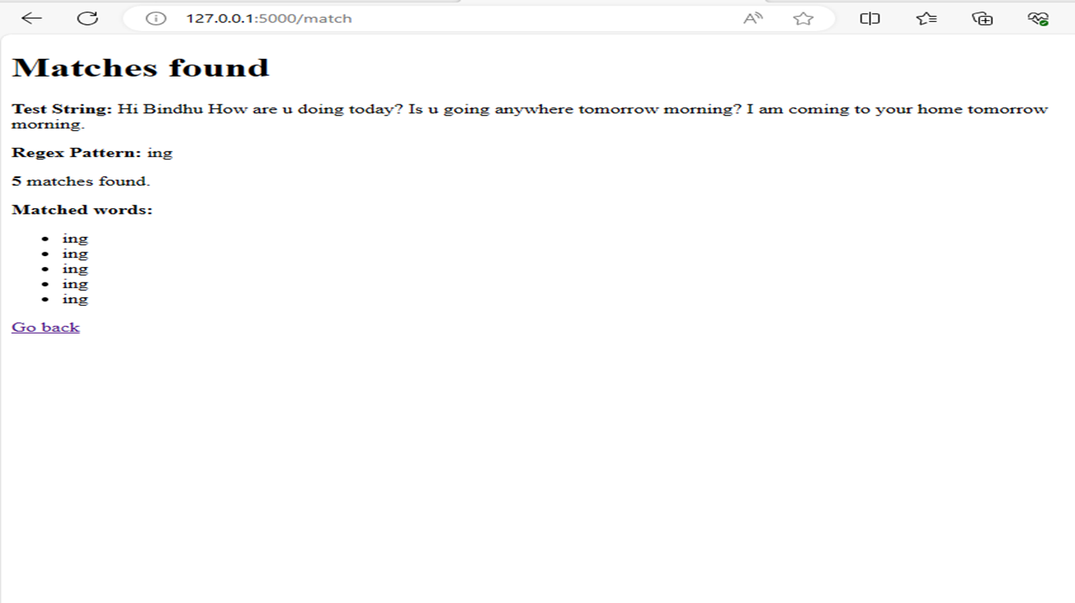


Slide 7
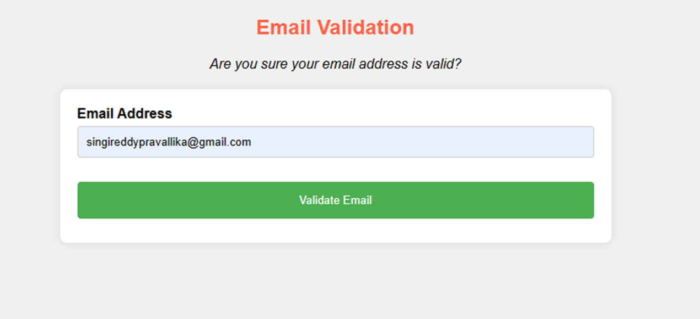

Slide 8
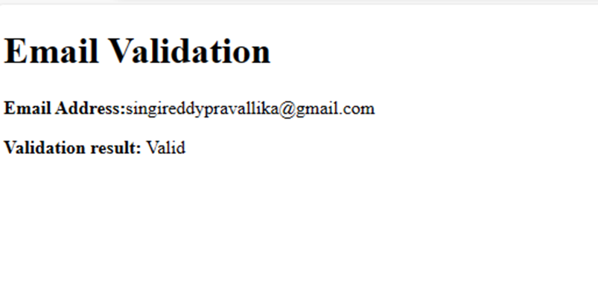

Slide 9

Test your application:
http://3.83.133.198:5000/

